Slide 1
Events Management: Principles & Practice, 4th Edition
By Razaq Raj and Tahir Rashid

Slide 2
Chapter 22 The Future of the Events Industry
These are some bullet points:
Challenges facing the events industry.
Key challenges are Covid-19, sustainability, globalisation, innovation and technology will impact greatly on the industry.
The global events industry has been growing rapidly in the West in the last decade but the Asia Pacific economies such as China and India are rapidly catching up.
The use of the internet, mobile technology and virtual applications will considerably affect the events industry.
The internet will continue to shape conferences and seminars as delegates may no longer need to attend these events.

Slide 3
Drivers For Change In The Global Events Industry
COVID-19 in 2020 and 2021 forced the events industry into lockdown.
As a result of the impact on the downturn in the economy, several organisations cut their budgets and reduced costs by laying off staff, cutting services and limiting business travel.
Event industry must adapt the new normal, where hybrid events will allow the industry to revive.

Slide 4
Event Post Covid-19 Safety Measures
1. Hygiene standards
Venues will be expected to demonstrate how they will be able to implement high level of hygiene standards.
2. Effective social distancing
Social distancing has been a critical factor in controlling the COVID-19 spread and event organisers will need to consider and plan for the flow of people.
3. Widespread vaccination
If the events industry is expected to get back on track after the pandemic, then the rates of vaccinations, vaccination passport and the effectiveness and efficacy of vaccine would play a major role.

Slide 5
Case Study 2014 Sochi Winter Olympic Games
Jobs and Economic Growth
Preparations for the Sochi Games created and supported an estimated 690,000 jobs.
In 2011, approximately 56,000 people worked on the Olympic construction sites
At the close of 2012, a total of 70,000 people were working on Olympic construction.
During the Games, Sochi had the lowest level of unemployment in Russia – just 0.17 percent.
Business activity in Sochi increased 178.8 percent from 2005-2010, compared to 101.2 percent in the Russian Federation as a whole.
By 2013, the Sochi 2014 Organising Committee was working with a total of 686 contractors, including 59 foreign contractors and more than 200 individual entrepreneurs.
The Sochi 2014 Organising Committee expects to announce a profit when its operations are finally wrapped up.

Slide 6
Evaluating Event and Festivals
Evaluating event success helps decision makers to adopt right economic, environmental and cultural policies for future events.
The evaluation of events and festivals seen as an essential step for organisers, local authorities, governments and key stakeholders to meet the global pressure brought by other competitors on marke.

Slide 7
Evaluating Event and Festivals
Evaluation is seen as a key decision-making tool for the organisers, event managers and local governments.
The organisers host the events for two main reason, improve the local economy by creating employment for local people and built infrastructure for local community use.
Create tourism for the local area for long-term to boost financial assets of the local businesses.

Slide 8
Post-event Evaluation
Social improvement for Local Community
Infrastructure
Increase in Tourism in Local Area
Increase Revenue for Local Businesses
Increase in Employment

Slide 9
Economic Evaluation
Raj and Musgrave (2009) in their framework of ‘three pillars impacts’

Slide 10
Measures and Procedures for Evaluation of Events
Monitoring and evaluation of events and festivals are important tool for managers.
Key economic and social achievements
Which key objectives has been met by the event
What strategies worked well and which strategies has failed to meet the expectations
Whether the event met the goals within set budget
What policies worked well in relation to marketing of event
Whether event achieved the visitors expectations
Whether impacts are equivalent with other similar events

Slide 11
Case Study Festival de Cannes, International Film Festival, France.
Estimated Impact of Festival de Cannes, International Film Festival
Festival generates 72 million euros per year approximately
85,000 visitors per year
476,000 commercial nights were spent in the local area
675,000 meals were consumed by these visitors
2,000 jobs are being created

Slide 12
Economic Impact and Assessment of Mega-events
Mega-events are seen by the key stakeholders as image makers, economic impact generators, and tourist attractions, overcoming seasonality, contributing to the development of local communities and businesses, and supporting key industrial sectors.
Mega-events attract visitors from all over the country and around the world.
Economic impact of the mega-events creates financial values for organisers to bring local governments on board and placing benefit of publicity obtained for the event

Slide 13
Social, Cultural and Environmental Impact of Events
Wallstam et al (2018, p.) argues that events and festivals organisers need to implement tools to evaluate the whole event by analysing the social impact.
“The concept of social impact is notoriously intangible and complex and, therefore, requires considerable attention in order for practitioners and policymakers to be able to operationalize it in evaluations of entire event portfolios”.

Slide 14
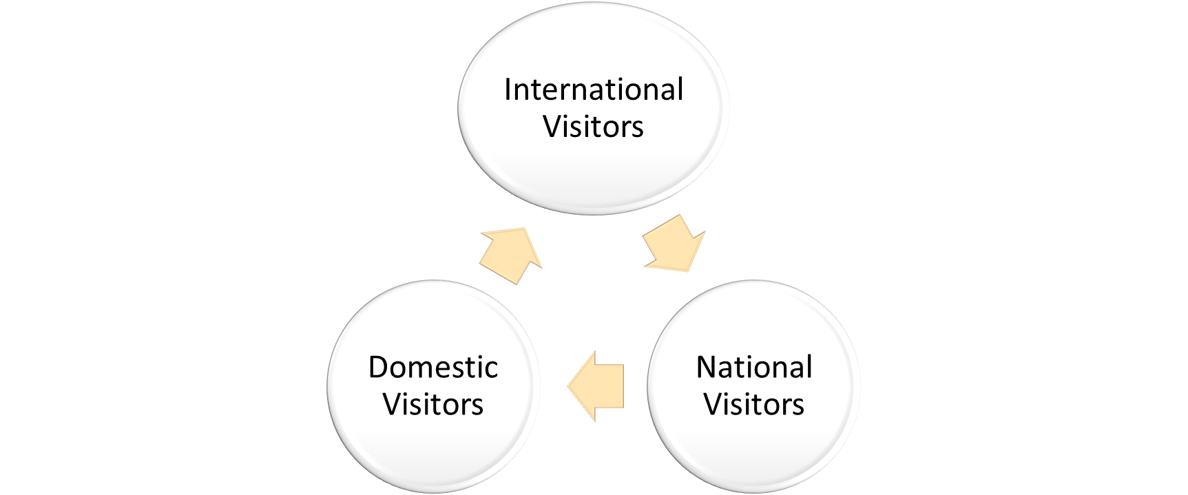
Event Visitor Evaluation
Classification of Event Visitors

Slide 15
Summary
The evaluation and impacts of events are now seen to be key principle in event industry to measure positive economic impacts on towns and cities.
The post-event evaluation is essential method for the organisers to analyse and identified and what social benefits has been achieved during the event and post-event.
The social and cultural impacts are vital to bring the local community on board.
Visitors experience act as an essential part in attracting national and international visitors to host city.

